Slide 1
Breathing

Slide 2
By the end of this Smart Lesson you should be able to:
1. | State the role of the diaphragm.
2. | Explain the difference between inhalation and expiration.
3. | Explain the function of the intercostal muscles do.

Slide 3
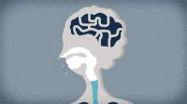
Breathing
Air enters through the nose and mouth. As air travels through the mouth and nasal passages, it is warmed and moistened.

Slide 4
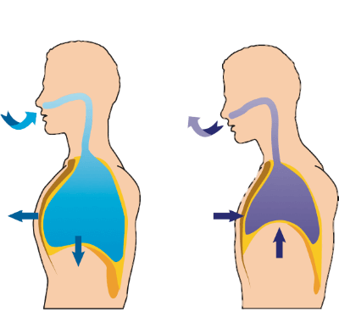
Breathing involves two processes:
Inhalation - breathing in; air rushes into the lungs, also called inspiration.
Exhalation - breathing out; air is forced out of the lungs, also called expiration.

Slide 5
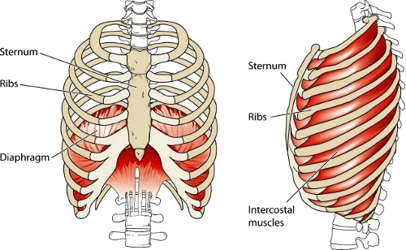
Why does your chest increase and decrease in size when inhaling and exhaling?
Well, the diaphragm and muscles between the ribs (called the intercostal muscles) are responsible for this!

Slide 6
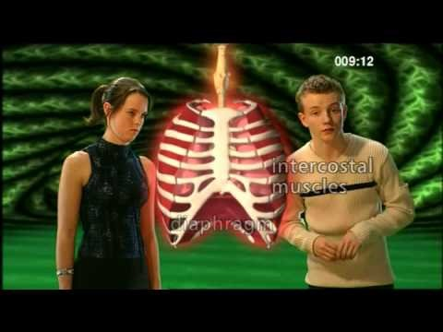

Slide 7
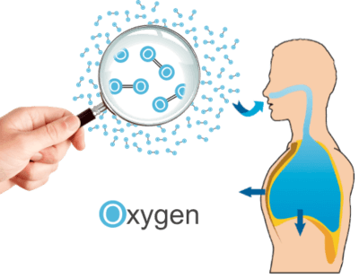
To inhale:
• We contract our diaphragm, pulling it down and flattening it.
• We contract our external intercostal muscles, pulling our ribs up and outwards.
Both of these mean our chest cavity (thorax) size is increased, so the lungs are pulled outward and air is pulled into our lungs, inflating them.

Slide 8
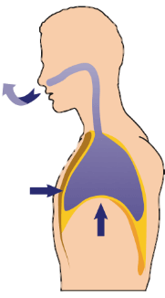
To exhale:
• We relax our diaphragm, so it moves upwards and curves.
• We contract our internal intercostal muscles, pulling our ribs down and inwards.
Both of these mean our chest cavity (thorax) size is decreased, so the lungs are pushed inward and air is pushed out of our lungs, deflating them.

Slide 9
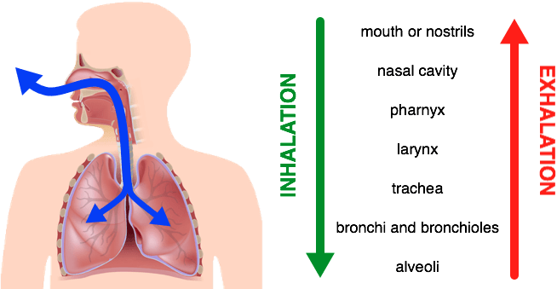
Summary of the direction that air moves as you inhale and exhale
• | Air and oxygen moves into (inhalation) the body through the mouth/nostrils to the nasal cavity, pharynx, larynx, trachea, bronchi and bronchioles, to the alveoli.
• | Carbon dioxide is exhaled (exhalation) in the opposite direction.
The diagram below summarises the direction of air as you inhale and exhale.

Slide 10


